Slide 1
Girl Scout Robotics Badge
This just covers the building of the robot car, not the entire badge. Use the guidebooks or the Volunteer Toolkit for the remaining badge steps.

Slide 2
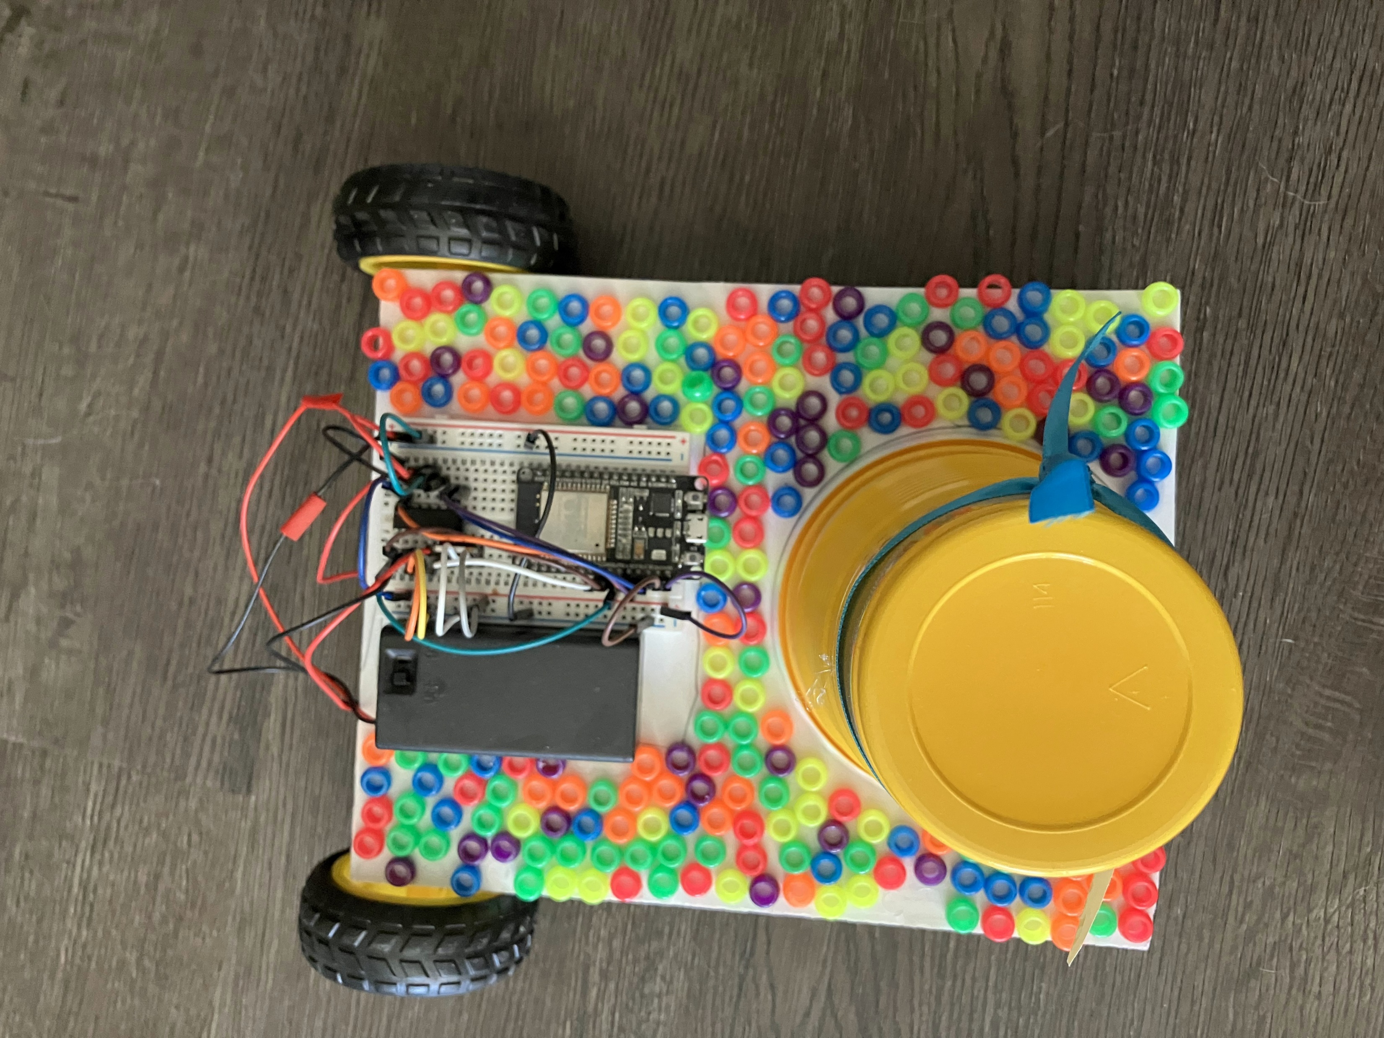
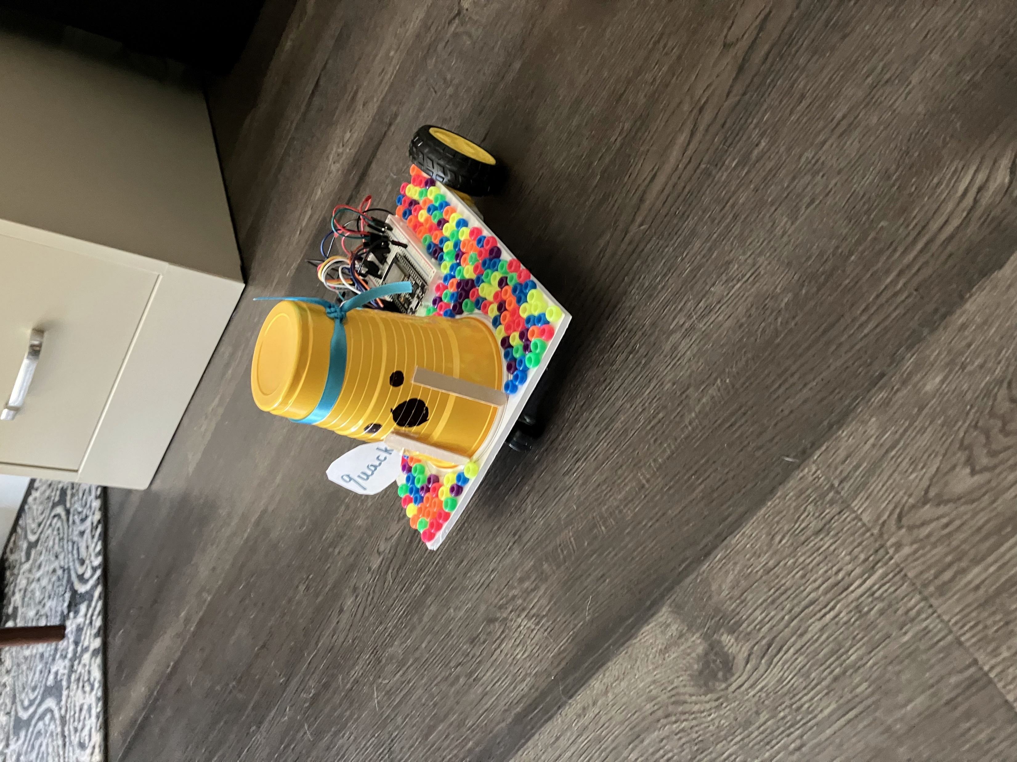
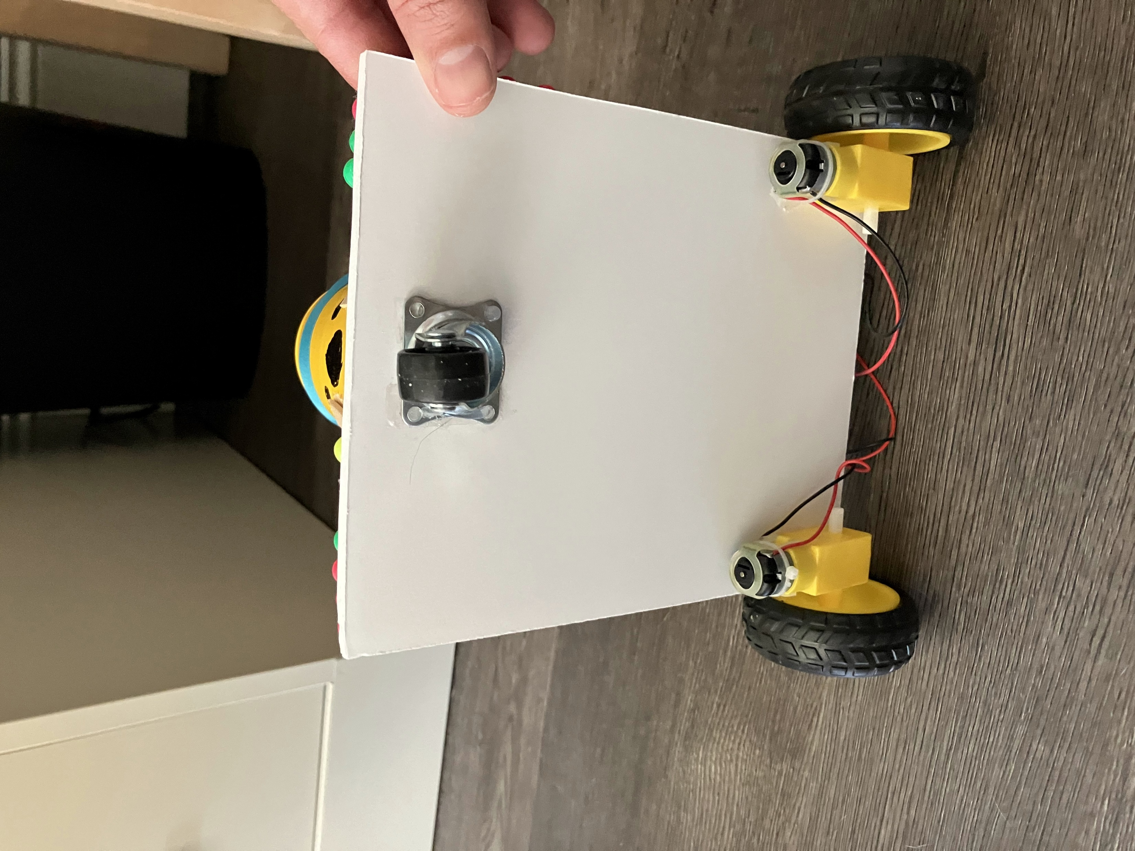
Example Car

Slide 3
Building the Car (Part 1)
The car can be made any number of ways. You can use lightweight wood or plastic for the body. We cut up old yard signs and used those. The key is making sure it’s large enough for all 3 wheels, and large enough to hold the circuit board. It also needs to be fairly light, or the car won’t move very well.
I recommend putting the three wheels (the spinning wheel plus the two motorized wheels) and the breadboard (white piece with all the holes to plug into) on first. This makes sure none of the decorations interfere with the key parts that make the car work.

Slide 4
Building the Car (Part 2)
Once the key parts are installed, the girls can decorate the car however they would like as long as they don’t interfere with the wheels, or make it too heavy. Keep in mind that the car drives around, so dangly pieces or anything loose will probably break off or get caught in a wheel

Slide 5
Building the Car (Part 3)
Once the key parts (wheels and breadboard) are done, and all decorations have been added, it’s time to build up the electronics.
The following pages show the details of how to build the electronics staring with a quick tutorial of how to use the breadboard

Slide 6
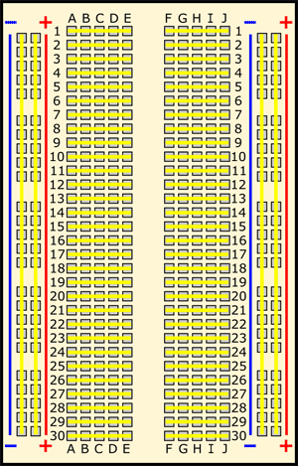
This is called a breadboard
We will connect the second power rail to 5V on the Arduino Nano board
All holes along the red line are called the “power rail” and are connected to each other. We will connect this to red wire of the 9V battery
We will connect the second ground rail to GND on the Arduino Nano board
All holes along the blue line are called the “ground rail” and are connected to each other. We will connect this black wire of the 9V battery
The yellow lines show which holes are connected

Slide 7
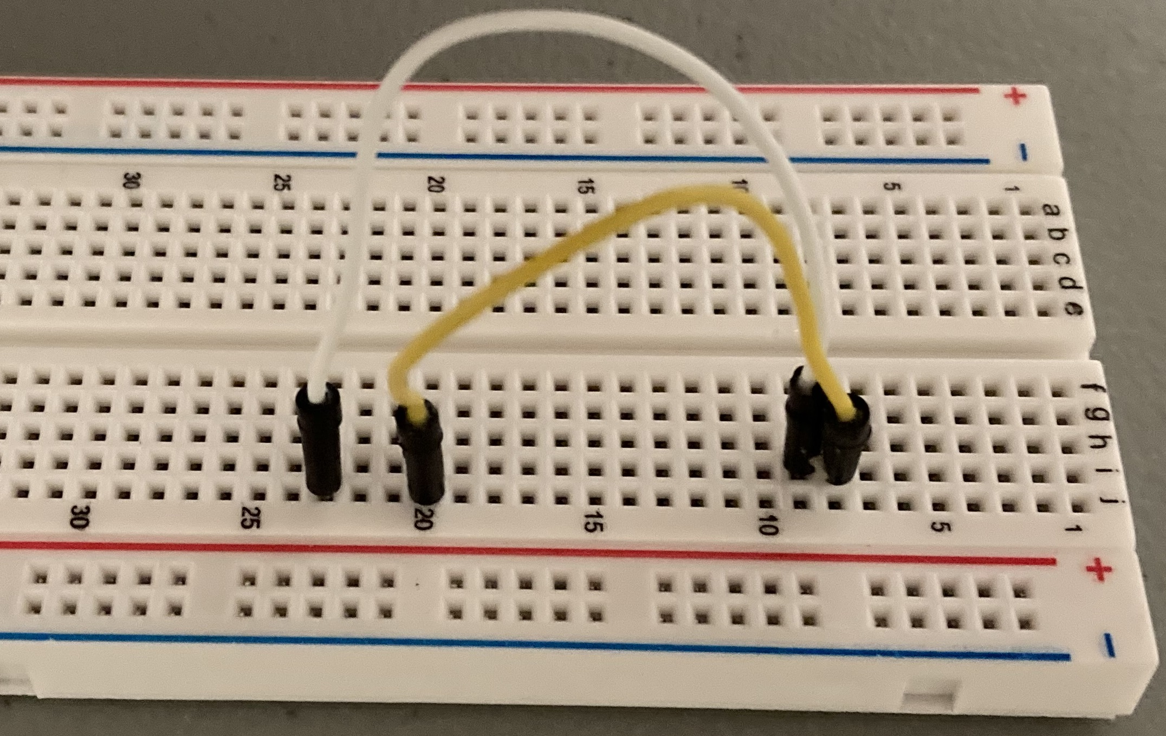
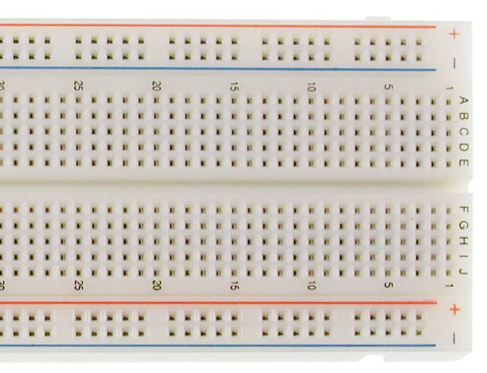
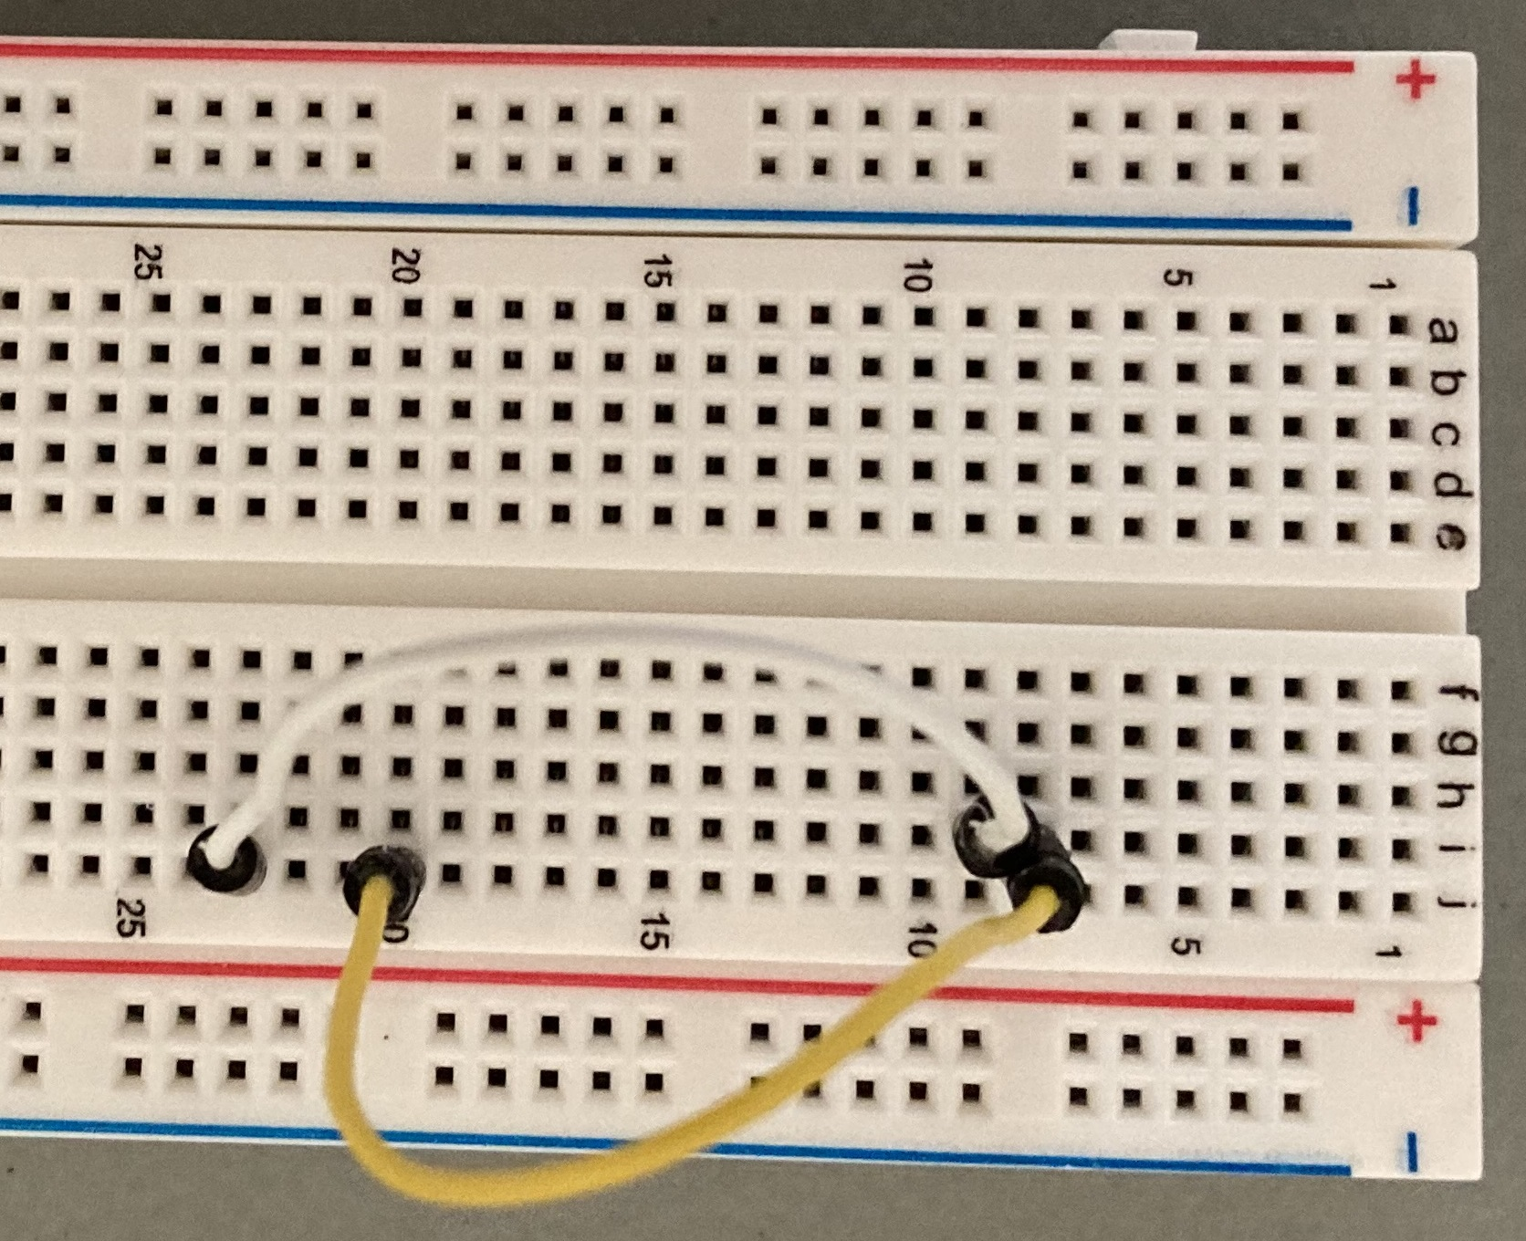
Wire color is not important
In the drawing below, you can see a red line from J23 to I9
The white wire in the picture to the right shows what that actually looks like
You can also see a black line from J20 to I8
The yellow wire in the picture to the tight shows what that actually looks like
Letters identify columns
Numbers identify rows

Slide 8
Electronics Assembly
Step by step instructions

Slide 9
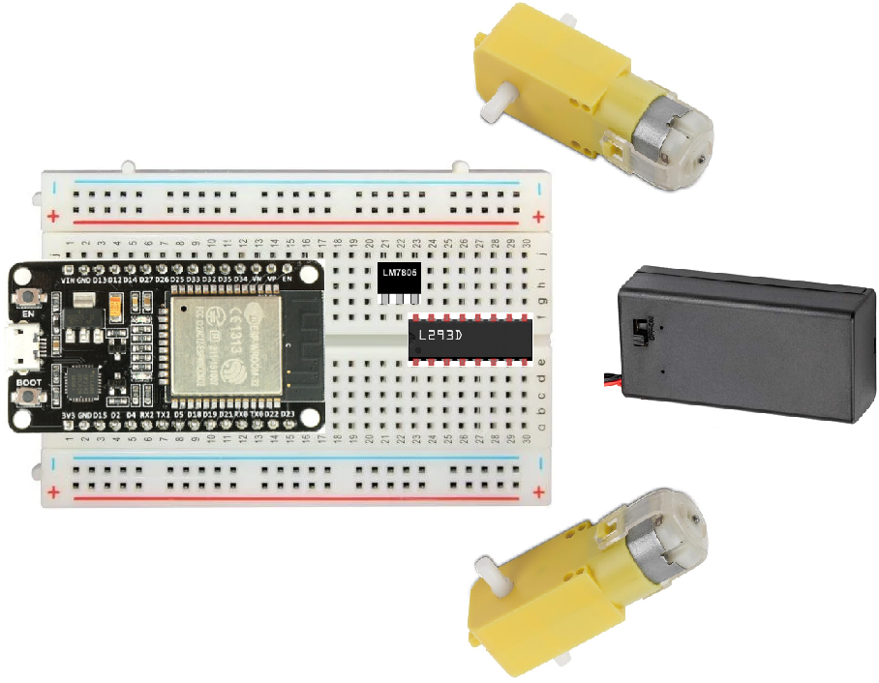
Put 3 chips in locations shown

Slide 10
Add 10 wires to connect power

Slide 11
Add 4 wires (2 per motor)

Slide 12
Add 2 wires for battery

Slide 13
Add 6 wires to connect processor to motors

Slide 14
Programming the Car
Once the electronics are assembled, you’ll need to program the car
To do this, install the PictoBlox software, and then follow the programming instructions
You have the option of modifying the PictoBlox software, but how to do that is not covered in this document

Slide 15
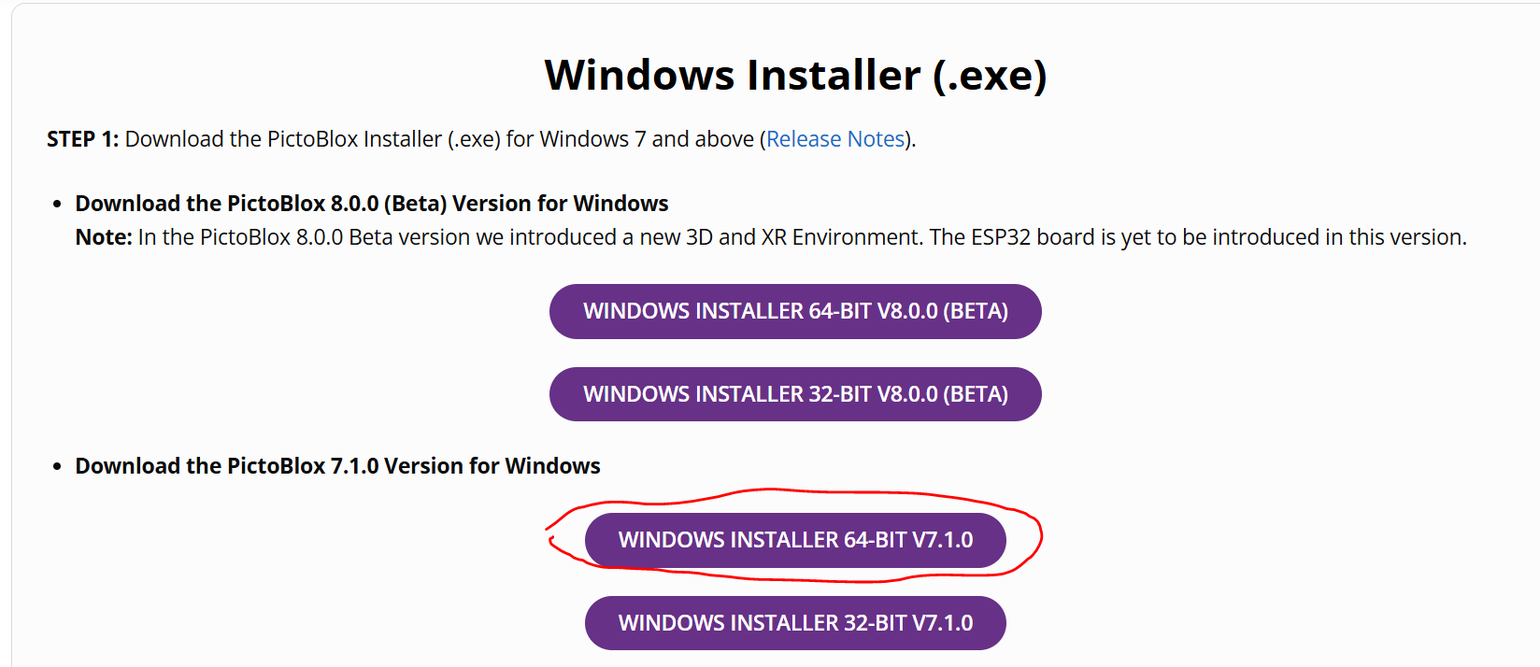
Install PictoBlox
One computer must have this software to program the cars. The computer needs a USB port.
If the students want to change the programming on their cars, they will also need this, but that’s optional.
Download the latest full release version of PictoBlox (not the one marked “Beta”. This tutorial uses version 7.1. You need to pick the correct operating system. For most people, this will be Windows 64 bit:
Download PictoBlox | Windows, MacOS, Linux, Chromebook, Android & iOS (thestempedia.com)
Follow the install steps on that page
At the end, you will be asked to install a driver, just click ”Install”. Sometimes the box doesn’t close after a successful install. Just click the “X”

Slide 16
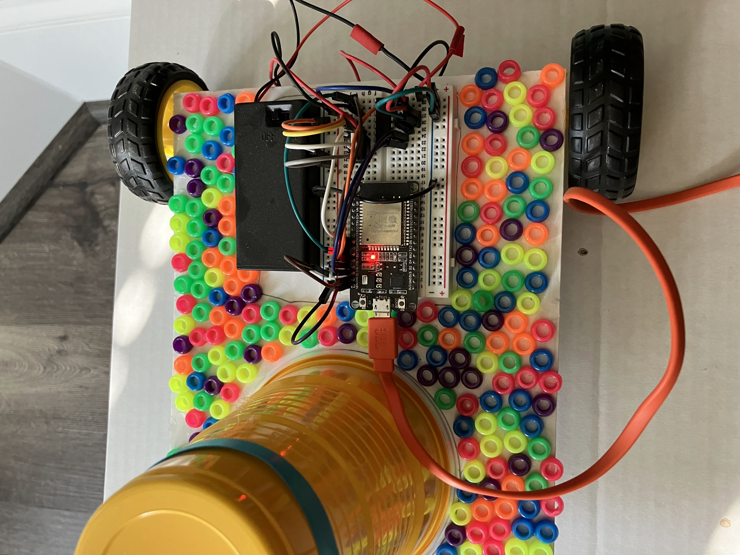
Connect the USB cable
Make sure the battery box is switched to “Off”.
Plug the USB cable into your PC and into the board on the car (the red light should come on)

Slide 17
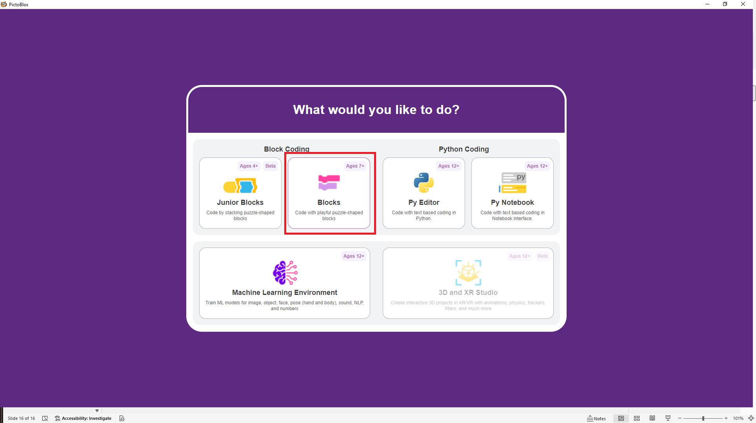
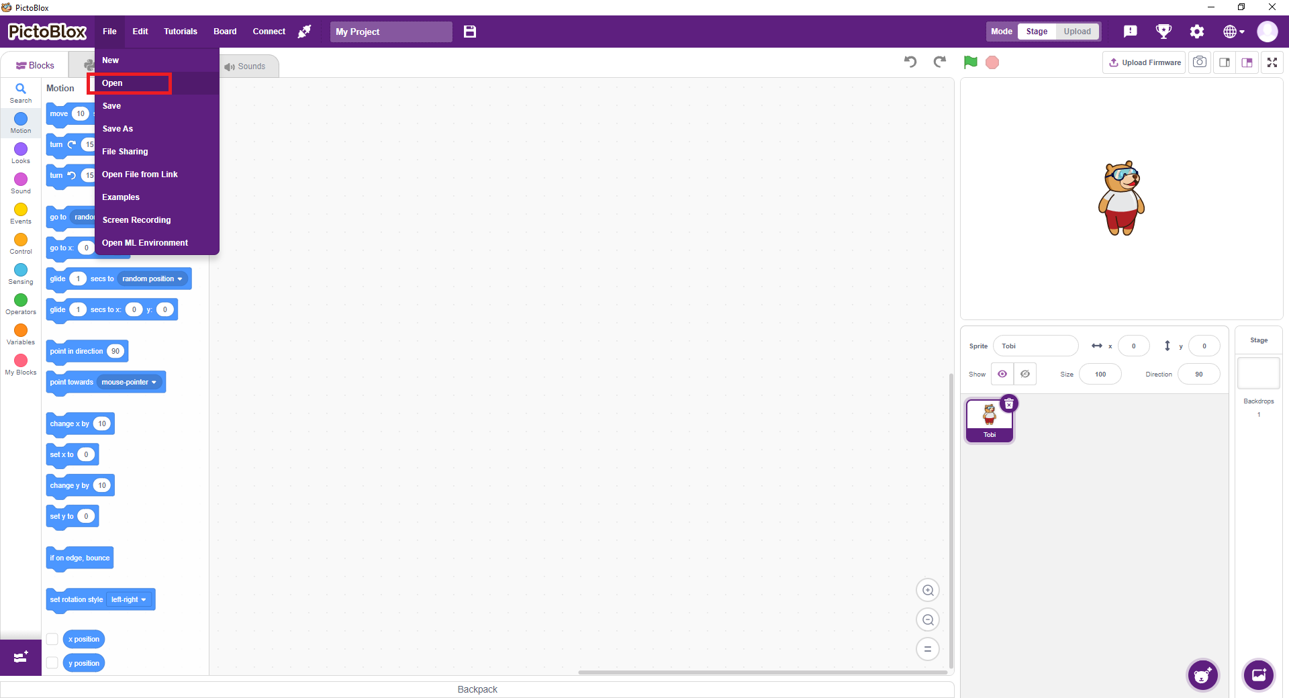
Open the PictoBlox file
Open the PictoBlox software and select “Blocks” for style of coding
Go to the “File” menu and click “Open”

Slide 18
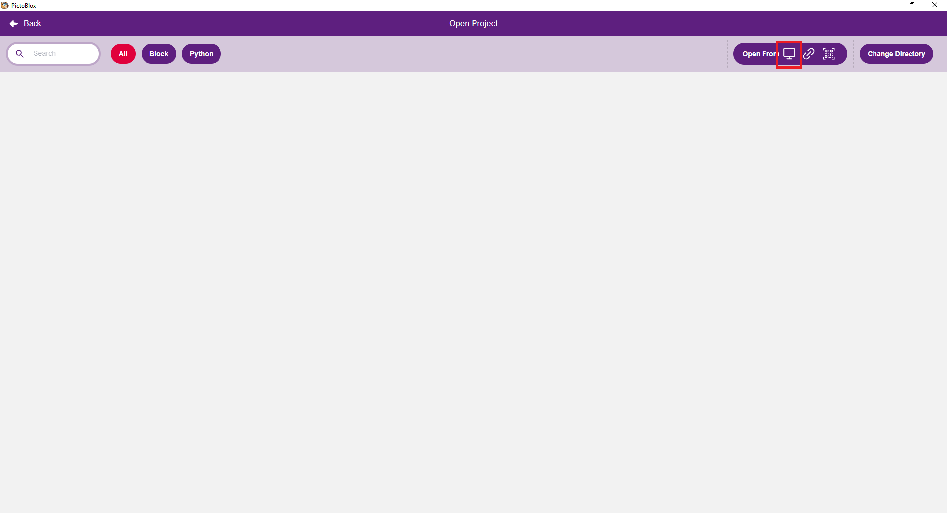
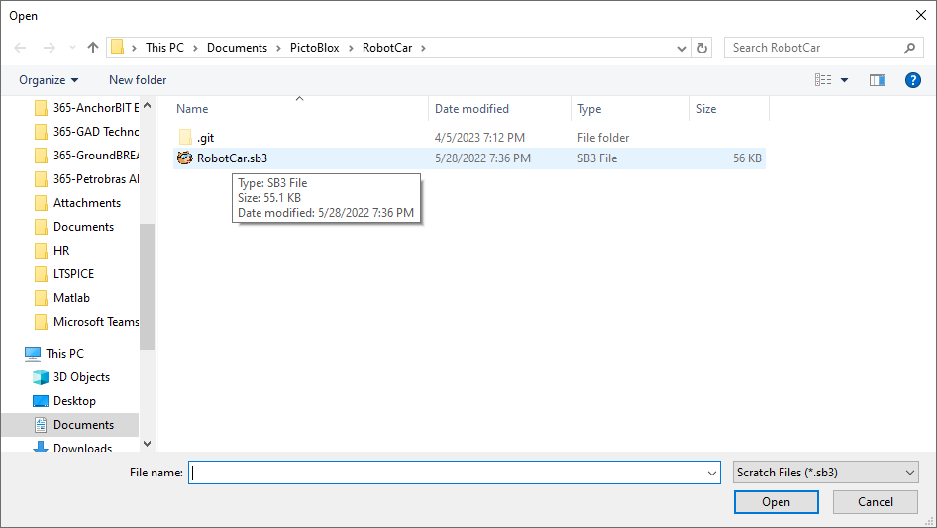
Open the PictoBlox file
On the top right, choose “Open From” with the computer picture
Select the “RobotCar.sb3” file you downloaded with these instructions

Slide 19
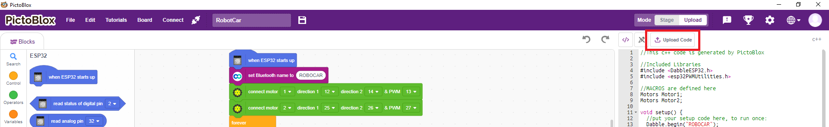
Upload the Firmware
In the upper right, choose “Upload”
The screen will change to look like this.
Change “ROBOCAR” in the purple block to a unique name (each girl should pick a unique name to avoid confusion)
Choose “Upload Code”

Slide 20
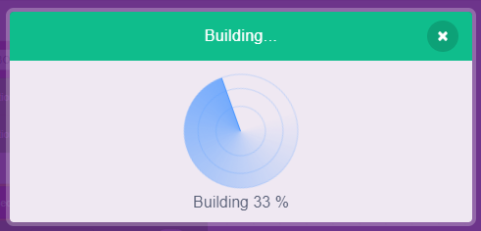
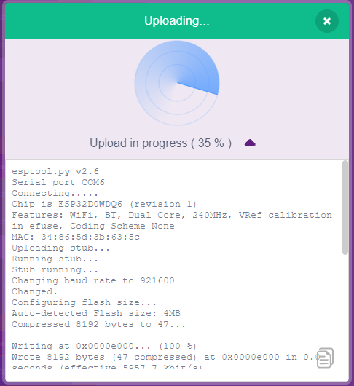
Upload the Firmware
Once you’ve clicked “Upload Code”, you should see this (it may stay for a couple minutes):
When the build is finished, it will show uploading like this:
When both are complete, you can unplug the USB cable

Slide 21

Install Dabble on a phone or tablet
On an iOS or Android tablet or phone, install the Dabble app using your app store. To make sure you get the correct one, it should look like this:
https://thestempedia.com/product/dabble/
The logo should look like:

Slide 22
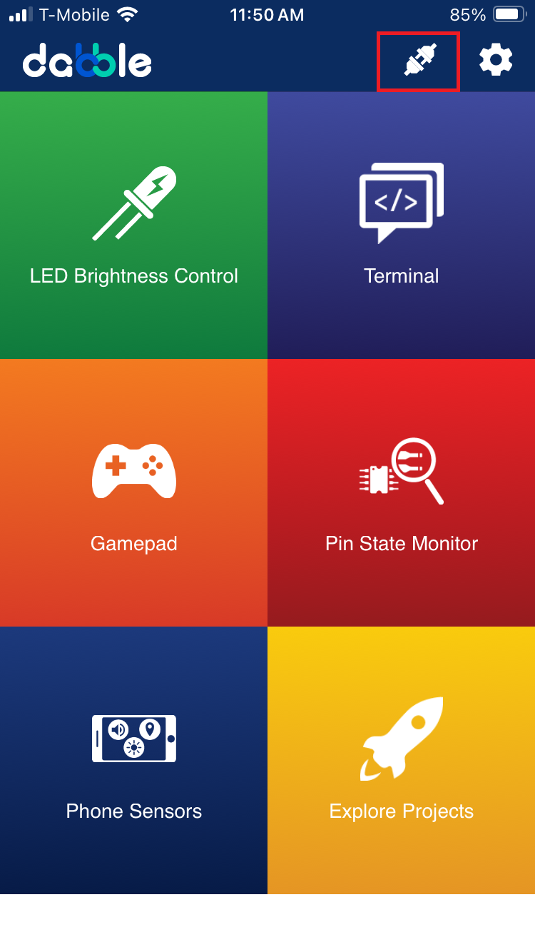
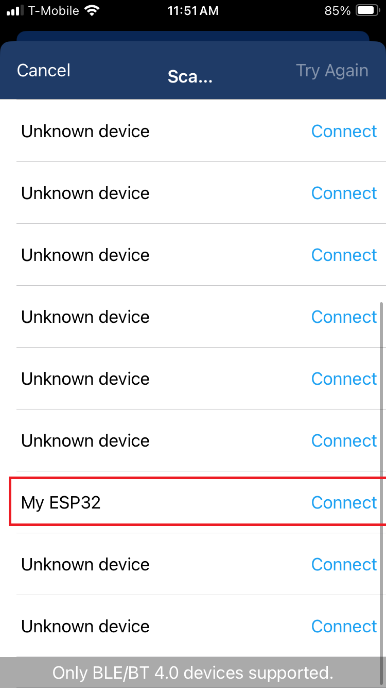
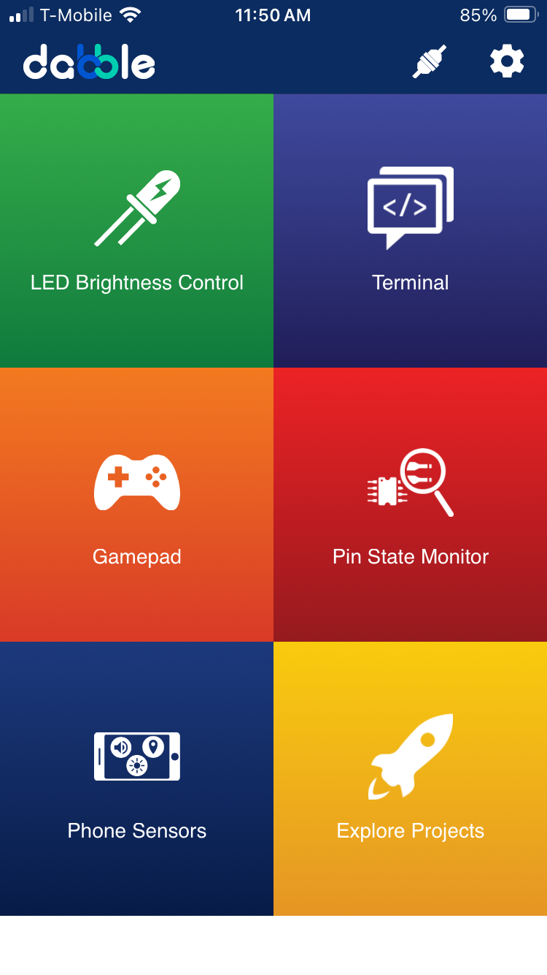
Connect your phone/tablet to the car
Make sure to turn the battery switch “on” before trying to connect
After installing dabble, open it and click the “connect” icon in the top right. Then, from the list, choose the unique name you gave your car (this is why it’s important to be unique, because there may be many in this list if many girls are building cars.
If it worked, the “connect” button will show closed

Slide 23
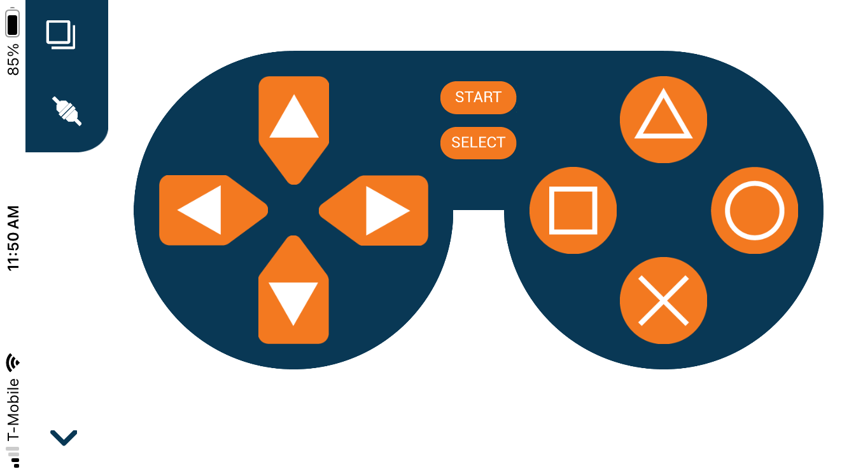
Install Dabble on a phone or tablet
Once connected, choose “Gamepad” from the main screen, and you’ll see the gamepad pop up.
Start/Select cause the blue light to turn on and off. The arrows control the car’s movement. The shapes don’t do anything (but you could program them to do something)

